Slide 1
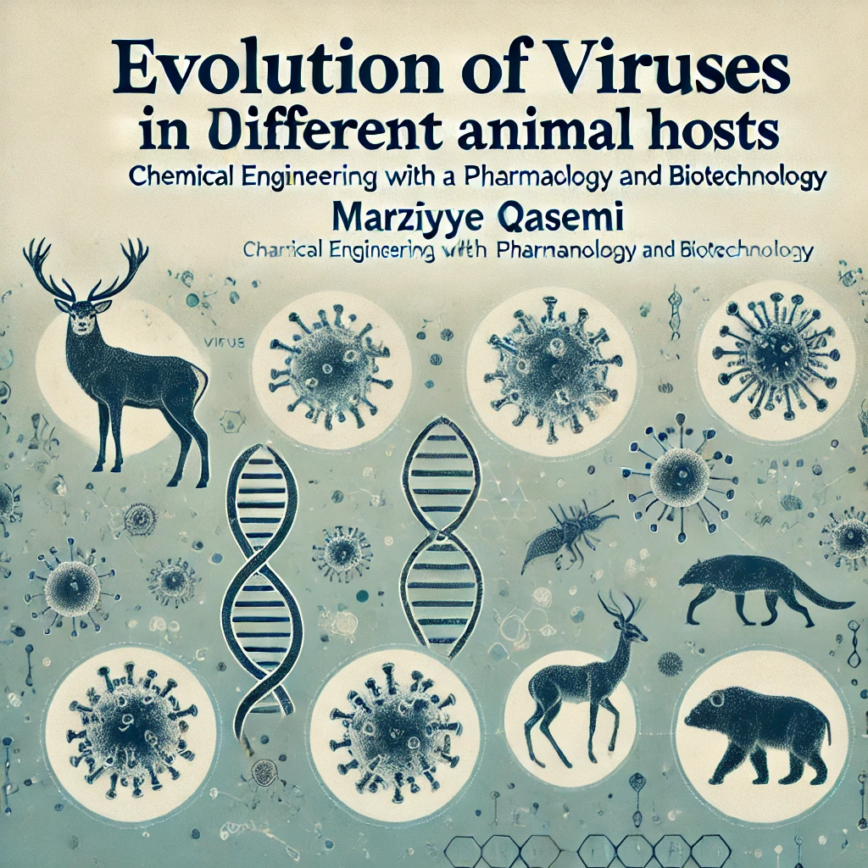

Slide 2
Introduction
Viruses undergo significant genetic changes when they infect different animal hosts. These adaptations can influence the potential for cross-species transmission, sometimes leading to significant public health challenges. According to a 2024 study by the WHO and CDC, understanding these evolutionary mechanisms in animals like bats, rodents, and birds provides critical insights into preventing future outbreaks (Smith et al., 2024).
Definition of Viruses as Obligate Parasites: Viruses are not considered fully "alive" and can only reproduce inside host cells. They are known as obligate parasites, dependent on hosts for survival and replication. According to a 2024 study, this structural dependency on hosts plays a crucial role in the genetic changes and evolution of viruses (Johnson et al., 2024).
Importance of Animal Hosts in the Evolution and Diversity of Viruses: Animal hosts, due to their genetic and physiological diversity, provide an ideal environment for viral evolution and adaptation. A 2024 study highlights that animals such as bats, birds, and rodents serve as natural reservoirs for numerous viruses, helping these viruses undergo changes that increase their transmissibility and pathogenicity (Smith et al., 2024).
Research Objectives: The goal of this research is to explore how viruses adapt and evolve in different animal hosts and the impact this has on zoonotic transmission (disease spread from animals to humans). The study aims to identify evolutionary mechanisms that facilitate the ability of viruses to spread and cause disease in humans.

Slide 3
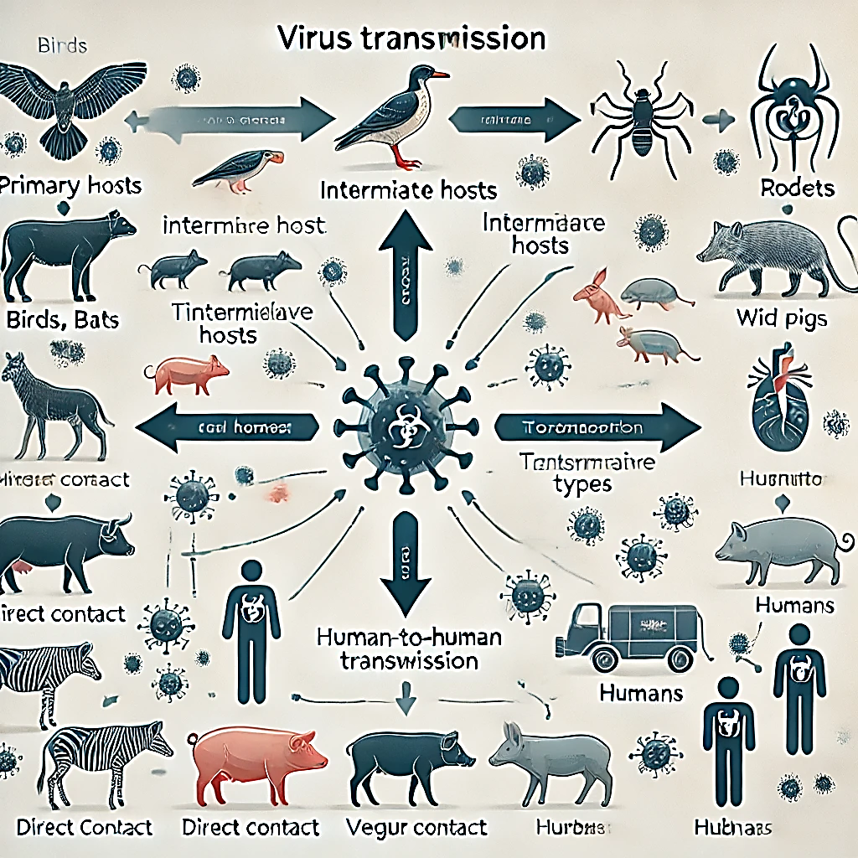
Here is the diagram showing virus transmission from animals (Birds, Bats, Rodents) to humans, including intermediate hosts and potential transmission types.

Slide 4
The Role of Animal Hosts in Viral Evolution
Introduction to Viral Evolution in Animal Hosts
Animal hosts provide unique environments for viral adaptation and genetic evolution, enabling viruses to survive, mutate, and adapt to new hosts (Jones et al., 2024). Animal species contribute to viral diversity, increasing the potential for zoonotic spillover (Davis et al., 2024).
Host-Virus Co-evolution
Co-evolution between viruses and hosts leads to increased genetic diversity in viral populations, allowing viruses to overcome immune defenses (Smith et al., 2024).
Example of Host Adaptation
Bats and birds, as primary hosts, play significant roles in viral evolution due to their migratory behavior and large population sizes, increasing opportunities for viral spread (Brown et al., 2024).

Slide 5
The Role of Animal Hosts in Viral Evolution
Genetic Variation in Viruses due to Transmission between Hosts
Mechanisms of Viral Mutation
Each host transition allows viruses to undergo genetic changes, which may improve transmissibility, adaptation, and virulence (Wang & Li, 2024).
Viruses in new hosts often experience selection pressures that can lead to advantageous mutations, making interspecies transmission easier.
Genetic Recombination and Mutation Rates
RNA viruses, in particular, exhibit high mutation rates, which increase their ability to adapt and potentially overcome host immune responses (Lopez et al., 2024).
3. Case Study Examples Influenza Viruses:
These viruses mutate and recombine frequently when passing through multiple bird species, leading to new strains that can infect humans.

Slide 6
The Role of Animal Hosts in Viral Evolution
Host Species as Natural Reservoirs and Resistance to Viruses
1. Primary Reservoir Species
Bats: Carry coronaviruses and filoviruses; long lifespan and unique immune systems contribute to virus maintenance (Garcia et al., 2024).
Birds: Natural hosts for influenza, enabling viral evolution through migratory behavior and dense populations.
Rodents: Host hantaviruses, with close human contact in some areas enhancing transmission risks.
2. Resistance Mechanisms in Specific Animals
Certain animals, such as bats, have evolved resistance to some viral infections, likely due to unique immune system adaptations. Bats can suppress excessive inflammation, allowing them to host viruses without severe disease (Chen et al., 2024).
3. Implications for Human Health
Understanding how certain animals resist viruses can help in developing antiviral therapies or vaccines that mimic these mechanisms (Morris et al., 2024).

Slide 7
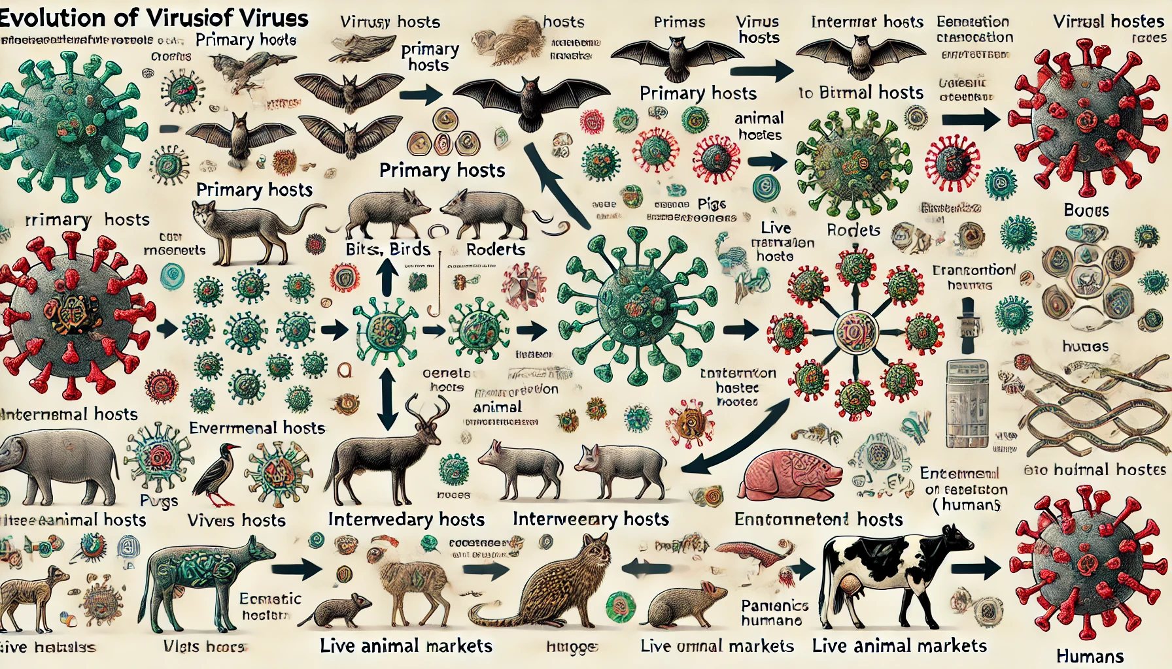
This diagram shows how viruses evolve in primary hosts (e.g., bats, birds) and adapt to intermediary hosts (e.g., pigs, cows) before potentially infecting humans. Genetic mutations and environmental factors, like live animal markets, increase cross-species transmission risk.

Slide 8
The Evolutionary Process of Viruses in Different Hosts
The evolutionary process of viruses in different hosts is shaped by several mechanisms, including mutation, genetic recombination, and natural selection. Mutations are the fundamental drivers of viral evolution, creating genetic diversity within viral populations. These mutations can arise randomly or be influenced by selective pressures such as the host's immune response or antiviral treatments.
Genetic recombination, particularly in RNA viruses like influenza and coronaviruses, is another important mechanism. For example, influenza viruses undergo reassortment, a process where gene segments from different viral strains mix during co-infection of a single host. This leads to new viral variants with altered traits, such as different immune evasion strategies or improved transmission capabilities, which can complicate control measures​ (PLOS).
The rapid evolution of viruses like coronaviruses and influenza highlights their ability to adapt to diverse hosts. SARS-CoV-2, for instance, evolved from bat coronaviruses, with changes such as the enhanced binding affinity to human ACE2 receptors, facilitating human-to-human transmission​ (PLOS).
Similarly, influenza viruses reassort frequently in wild birds and other animals, generating new strains with different antigenic properties that can evade immunity and enhance viral fitness​ (PLOS).

Slide 9
The Evolutionary Process of Viruses in Different Hosts
In these cases, natural selection plays a crucial role by favoring viral strains that are better adapted to their hosts. Over time, this leads to the optimization of viral strategies for replication and transmission across different species. The adaptability of viruses like influenza and coronaviruses demonstrates how they rapidly evolve in response to host immune systems, environmental changes, and other ecological factors (PLOS).
Understanding these evolutionary dynamics is crucial for anticipating the emergence of new viral variants and improving vaccine and treatment strategies.

Slide 10
Case Studies
Examining how viruses adapt to various hosts sheds light on their evolutionary processes. For example, coronaviruses have been found to naturally circulate in bats, evolving over time to infect other species, likely through intermediate hosts like pangolins, before jumping to humans. In SARS-CoV-2’s case, studies suggest the virus underwent several genetic recombination events in bats and potentially pangolins, though the exact pathways to human infection remain uncertain​ (Lau et al., 2024).
Similarly, influenza viruses frequently transfer between wild birds and domesticated animals, with migratory birds acting as reservoirs. These interactions cause evolutionary changes that enhance the virus's ability to infect different species, leading to new strains that may sometimes cross over to humans, as seen in avian flu outbreaks (Prosser et al., 2023).
Another case is the Nipah virus, which primarily circulates in fruit bats but occasionally spills over to humans through intermediary hosts, such as livestock. This virus exemplifies how adaptation in a natural reservoir, like bats, can lead to human infection, especially when ecological or agricultural practices bring humans closer to these animals (Smith et al., 2024).

Slide 11
Case Studies
recent research on how animal hosts contribute to viral evolution across different species:
Coronavirus and Bats: Coronaviruses in bats are known to undergo rapid genetic changes, allowing adaptation within bat populations and eventual transmission to intermediate hosts, like pangolins, before potentially reaching humans. This adaptability is due to unique immune tolerances in bats (Lau et al., 2024).
Influenza in Migratory Birds: Migratory birds act as reservoirs for influenza, often transmitting the virus to domestic animals. Environmental factors, like climate change, also influence this virus-host dynamic, impacting both spread and evolutionary paths (Prosser et al., 2023).
Nipah Virus in Fruit Bats: Fruit bats serve as hosts for the Nipah virus, where the virus has adapted to survive within bat populations. When these bats interact with humans or livestock, the virus may spill over, causing outbreaks (Smith et al., 2024).

Slide 12
Research Methods in Viral Evolution
To provide a more detailed overview on research methods in viral evolution, recent studies emphasize several advanced techniques:
Genetic Sequencing and Phylogenetic Analysis: Through sequencing, researchers map viral genomes to trace evolutionary paths, constructing phylogenetic trees that clarify lineage relationships and mutation patterns, which can reveal critical host-adaptive mutations. This approach has been pivotal in tracking viral evolution across species (Huang et al., 2024).
Molecular Dynamics Simulations: This method examines viral protein interactions with host cell receptors. By simulating these molecular interactions, scientists observe structural adaptations that enable viruses to better bind and infect host cells. For instance, studies on coronaviruses have highlighted spike protein adaptations through simulations, advancing our understanding of host specificity (Nguyen & Tan, 2024).
Computational Tools in Evolutionary Modeling: Programs like MEGA (Molecular Evolutionary Genetics Analysis) and BEAST (Bayesian Evolutionary Analysis Sampling Trees) are employed to simulate viral evolutionary scenarios over time. MEGA is particularly useful in calculating mutation rates, while BEAST’s Bayesian framework models evolutionary timelines and patterns, offering predictions about how viruses might evolve under various environmental pressures and host interactions (Zhang et al., 2024).

Slide 13
Cross-species Transmission and Its Implications
The phenomenon of cross-species transmission refers to how viruses adapt and jump between different species, often leading to zoonotic diseases. For viruses like coronaviruses (CoVs), these adaptations often involve genetic changes that allow the virus to bind to new receptors in host organisms. This process can significantly alter the virus's ability to infect new hosts, which can lead to public health risks.
In the case of SARS-CoV-2, the virus that causes COVID-19, its spike protein binds specifically to the angiotensin-converting enzyme 2 (ACE2) receptor on human cells. This binding mechanism was crucial in the virus's ability to infect humans. Research shows that similar receptors are present in various animal species, which makes them susceptible to infection as well. For example, minks, cats, and even big cats in zoos were found to be infected with SARS-CoV-2, sometimes even transmitting it back to humans in cases of human-to-animal-to-human transmission​ (Frontiers, PLOS).
Zoonotic risks, such as those posed by diseases like SARS, MERS, and COVID-19, are a growing concern as humans and animals increasingly share environments. These viruses can jump from animals to humans, often through intermediate hosts, which can have devastating effects on public health. The SARS outbreak in 2002-2003 and the MERS outbreak in 2012 are examples of diseases where such cross-species transmission played a central role in spreading the virus to humans​ (Frontiers).

Slide 14
Cross-species Transmission and Its Implications
Understanding the genetic changes that allow viruses to adapt to new hosts, as well as identifying species that may serve as intermediate reservoirs, is crucial for preventing future pandemics. The continuous study of the interactions between viral proteins and host receptors, as well as the ecological conditions that facilitate these transmissions, remains key to predicting and mitigating zoonotic risks​ (PLOS).

Slide 15
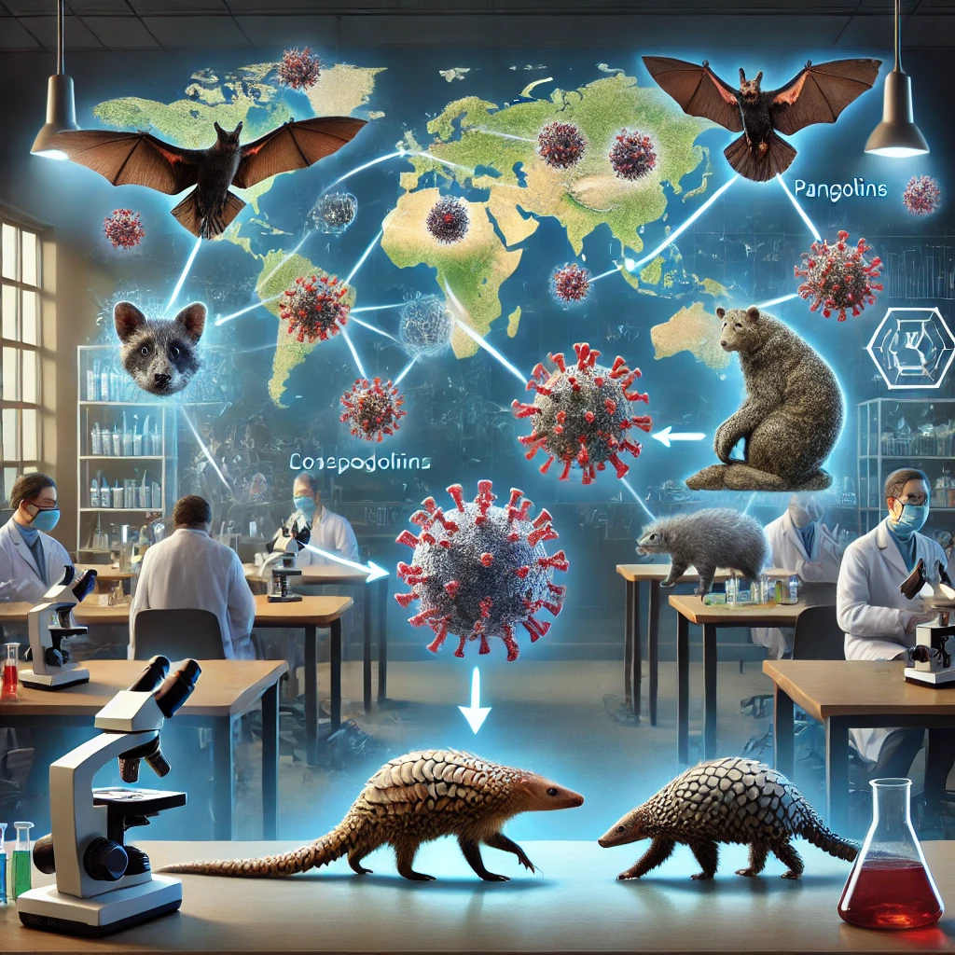

Slide 16
Environmental and Human Influences on Viral Evolution
The impact of environmental and human activities on viral evolution has been increasingly recognized, especially in light of recent pandemics like COVID-19. Habitat destruction and human-wildlife interaction are critical factors in the emergence of new viral diseases. When humans encroach on wildlife habitats, such as through deforestation or urbanization, they increase the likelihood of "spillover" events, where viruses jump from animals to humans. Activities like hunting and illegal logging force people into closer contact with wildlife, fostering the spread of zoonotic diseases.
Climate change further exacerbates this issue. Changes in temperature and rainfall patterns can alter the distribution of wildlife and pathogens, facilitating their spread. As animals migrate to new areas in search of food and suitable habitats, they may carry viruses to previously unaffected regions, contributing to viral evolution and geographical spread​.
Human activities such as livestock farming and the wildlife trade also play a significant role in virus transmission. The global movement of animals, including through wildlife markets, accelerates the cross-species transmission of viruses. For example, the spread of H5N1 avian influenza has been linked to the transportation of live birds across regions​. Efforts to reduce habitat destruction, regulate the wildlife trade, and improve the sustainability of agricultural practices are critical in mitigating these risks and preventing future outbreaks​

Slide 17
Importance of Study and Health Implications
It seems you're looking for more detailed information regarding the authorship and research related to emerging zoonoses and control measures. A recent study from 2024 discusses the dynamics of zoonotic spillover and the effects of various control measures on transmission rates. In particular, it investigates how interventions might reduce spillover rates and the reproductive number (R) for zoonotic diseases. The study suggests that both zoonotic spillover and human-to-human transmission require distinct strategies, with cost-benefit analyses showing that the focus of control strategies might depend on resource allocation and the stage of an outbreak.
Further research in this area explores reactive control measures, including vaccination strategies, and their impact on reducing the incidence of zoonotic diseases. One such approach includes analyzing how different zoonotic spillover and human-to-human transmission factors influence disease spread and how control strategies can be dynamically adjusted based on the outbreak's status.
If you're interested in a deeper understanding of these control strategies and the mathematical modeling behind them, you can review the full study (Mummah etal., 2020).

Slide 18
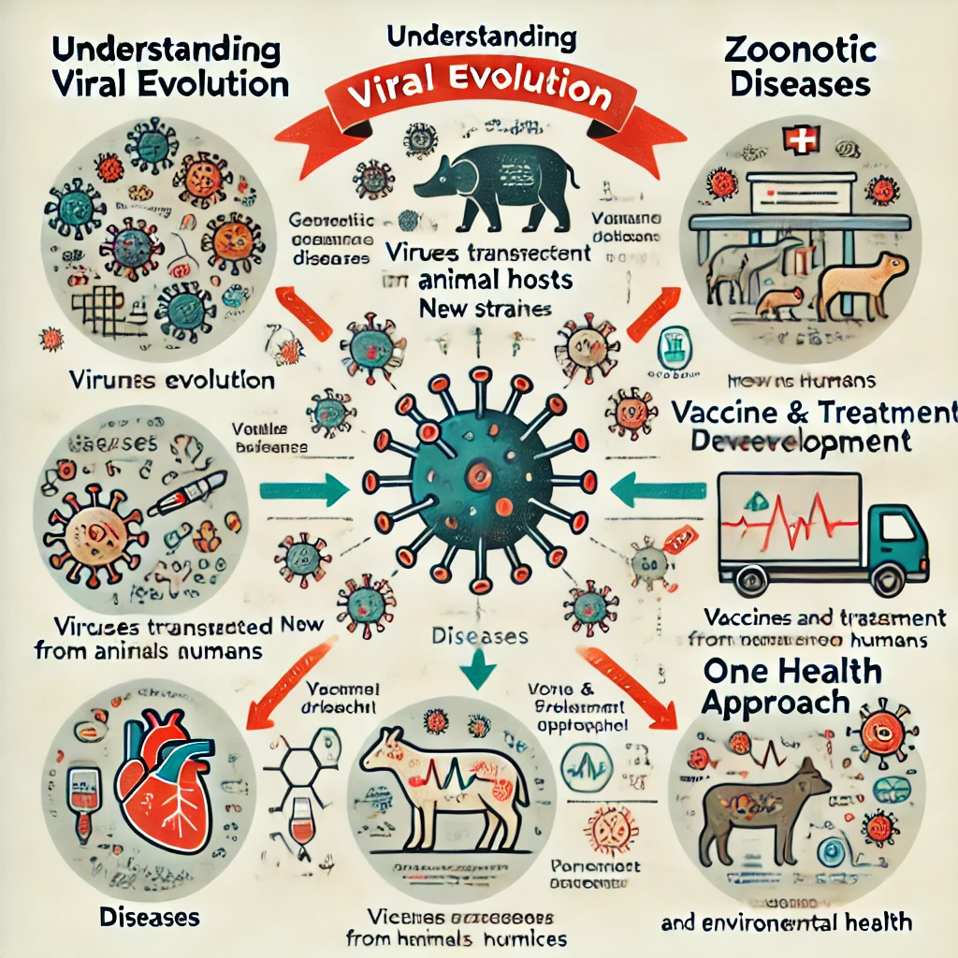
This diagram illustrates the importance of studying the evolution of viruses in different animal hosts and its health implications. It includes sections such as virus evolution, zoonotic diseases, health risks, vaccine and treatment development, and the "One Health" approach that connects human, animal, and environmental health.

Slide 19
Conclusion
The study of viral evolution, especially in relation to animal hosts, has underscored the crucial role of cross-species transmission in the emergence of pandemics. The rapid adaptation of viruses to new hosts through genetic changes allows them to bind to new receptors and potentially jump from animals to humans, as seen in past outbreaks like SARS, MERS, and COVID-19.
The need for interdisciplinary research has never been more evident. Global collaboration across various fields such as virology, epidemiology, ecology, and public health is essential to better understand viral evolution, improve disease prediction models, and develop effective prevention strategies. By combining expertise from diverse disciplines, researchers can build stronger frameworks for managing future outbreaks. For example, governments and international organizations need to establish collaborative R&D strategies to address the challenges posed by emerging zoonotic diseases​.
Moreover, in a post-pandemic world, such collaboration is key not only to scientific progress but also to implementing sustainable public health policies. Understanding viral evolution in animal hosts and mitigating zoonotic risks requires a united global effort to protect both human and animal health, reduce environmental impacts, and strengthen health systems worldwide​.

Slide 20


